Slide 1
Privilege 101
Student Health and Human Services
Human Relations, Diversity and Equity
July 2022
Notes:
Teacher, please feel free to encourage student participation whichever way you are most comfortable: in the Zoom chat, on a previously shared Jamboard, in break out groups, or all together in a grid view.

Slide 2
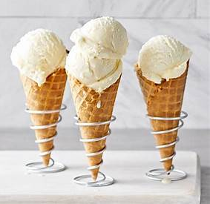
Check-In
Which flavor of ice cream do you prefer?

Slide 3
Objectives
1
Understand the basic definition of privilege
2
Reveiw several common types of privilege
3
Consider types of privilege and it’s impact on your life and the lives of others
4
Use awareness of one’s own privilege to become a more effective ally

Slide 4
The phrase “check your privilege” is popular. But what does that mean?

Slide 5
What is privilege?

Slide 6
Privilege Walk Exercise
Watch the video.
What themes appear?
What types of privilege can you identify?
Notes:
DO NOT conduct privilege walk exercises with students or staff. The exercise can be exploitive and shameful.
This is a conversation starter about societal and individual patchworks of privilege.
Every group has its own internal system by which power and privilege are levied, such as sexual orientation, color, religion, [dis]ability, education, socio-economic status.
https://youtu.be/hD5f8GuNuGQ
4:00

Slide 7
Common Types of Privilege
White Privilege
Heterosexual Privilege
Religious Privilege
Socio-economic Privilege
Gender Privilege
Able-bodied Privilege
Cisgender Privilege
Colorism
And many more!
Some types privilege can change over time based on circumstances, popular culture and norms, also known as social constructs.

Slide 8
As a child, Winnie Harlow was shunned for having vitiligo, a condition that causes loss of skin color. Now she is a top model. I'm not a 'Vitiligo model,'" Harlow wrote. "I am Winnie. I am a model. And I happen to have Vitiligo. Stop putting these titles on me or anyone else.”

Slide 9
Intersectionality
Each person’s identity is complex and made up of several different components. We call that Intersectionality.
Because of this-
People may experience privileged in some areas but lack of privilege in others
Notes:
Recall the woman from the privilege walk exercise video that was in the back. She identified as black, a woman, and a lesbian which are all types of oppressed groups. Could she have other privileges, such as related to disability, religion, education….?
A white man who uses a wheelchair may be privileged by race and gender but lack privilege due to ableism.

Slide 10
Visible v. Invisible Identities
Visible:
A woman
Black
A Muslim
Invisible:
Sexual orientation
Nationality
Immigration status
[Dis]abilities
Education
Socio-economic status

Slide 11
How can you help? By being a good ally!
Notes:
https://youtu.be/_dg86g-QlM0
3:31

Slide 12
5 Tips for Being an Ally
“Privilege does not mean that you are rich, that you had an easy life, that everything’s been handed to you and you’ve never had to struggle or work hard. All it means is that there are some things in life that you will not experience or ever have to think about just because of who you are.”
1. Understand your privilege
2. Listen and do your homework
3. Speak up not over
4. You’ll make mistakes; apologize when you do
5. Ally is a verb

Slide 13
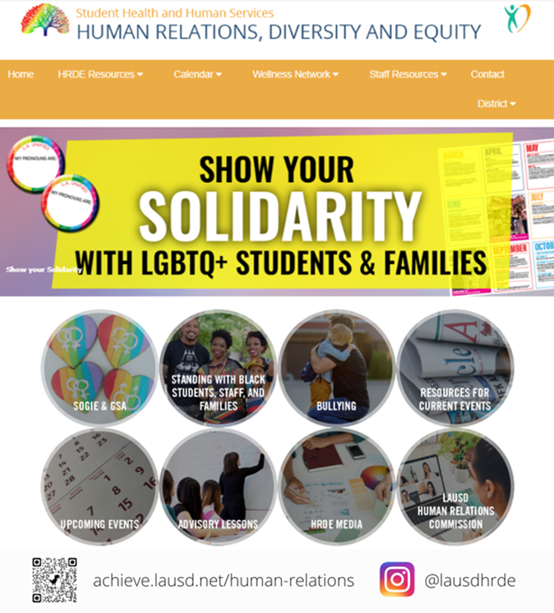
Human Relations, Diversity & Equity

Slide 14
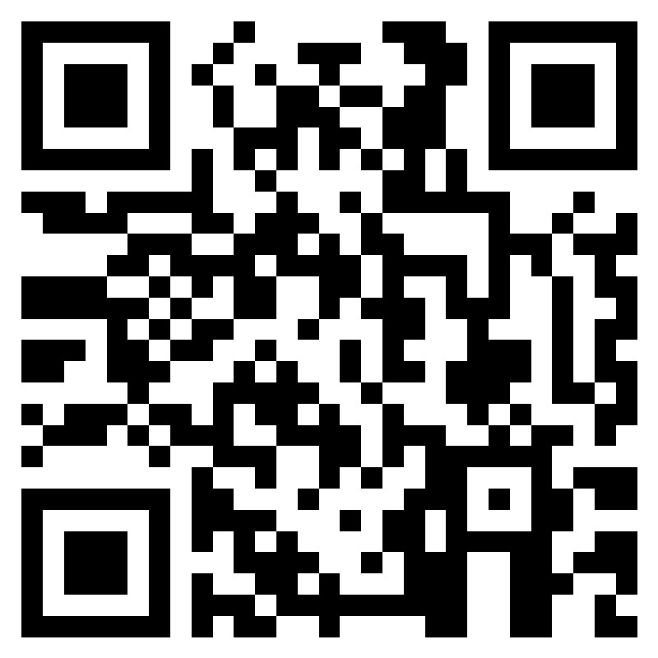
Teacher Feedback
Notes:
Teacher, please complete the brief feedback survey by scanning the QR code or using the link below
https://forms.office.com/r/i9UqyyxzTT

